Slide 1

Leveraging Weather Events to Maximize Airline Stock Portfolio
Sam Lawhead
Jon Mitchell
Virginia Murage
Chandler Schaak

Slide 2
Executive Summary
As our climate changes, the airline industry is seeing more and more cancellations & delays
Airline success (i.e. generating profits) is very dependent on efficient operations
Our Hypothesis is that when airlines see significant disruptions at their main hubs, there should be a decrease in the stock price in the days afterwards
If theory holds true, there is a market inefficiency that can be exploited with accurate weather modeling

Slide 3
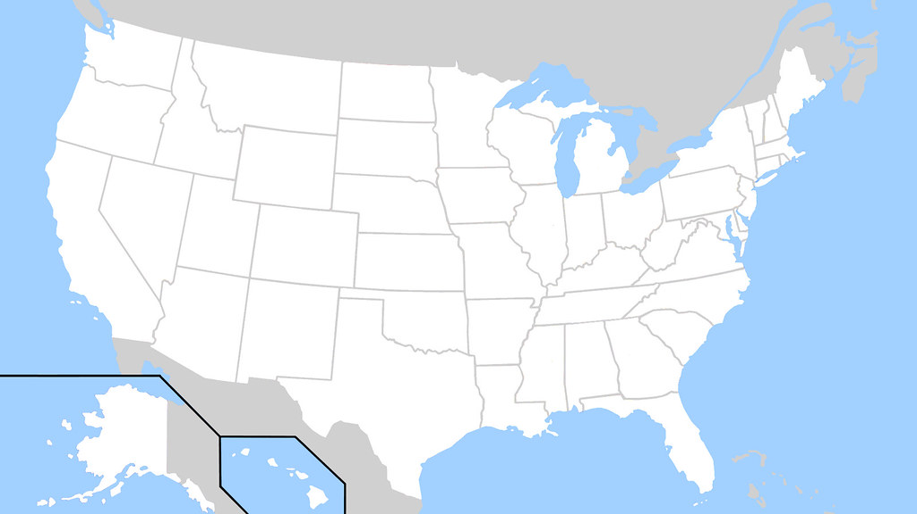




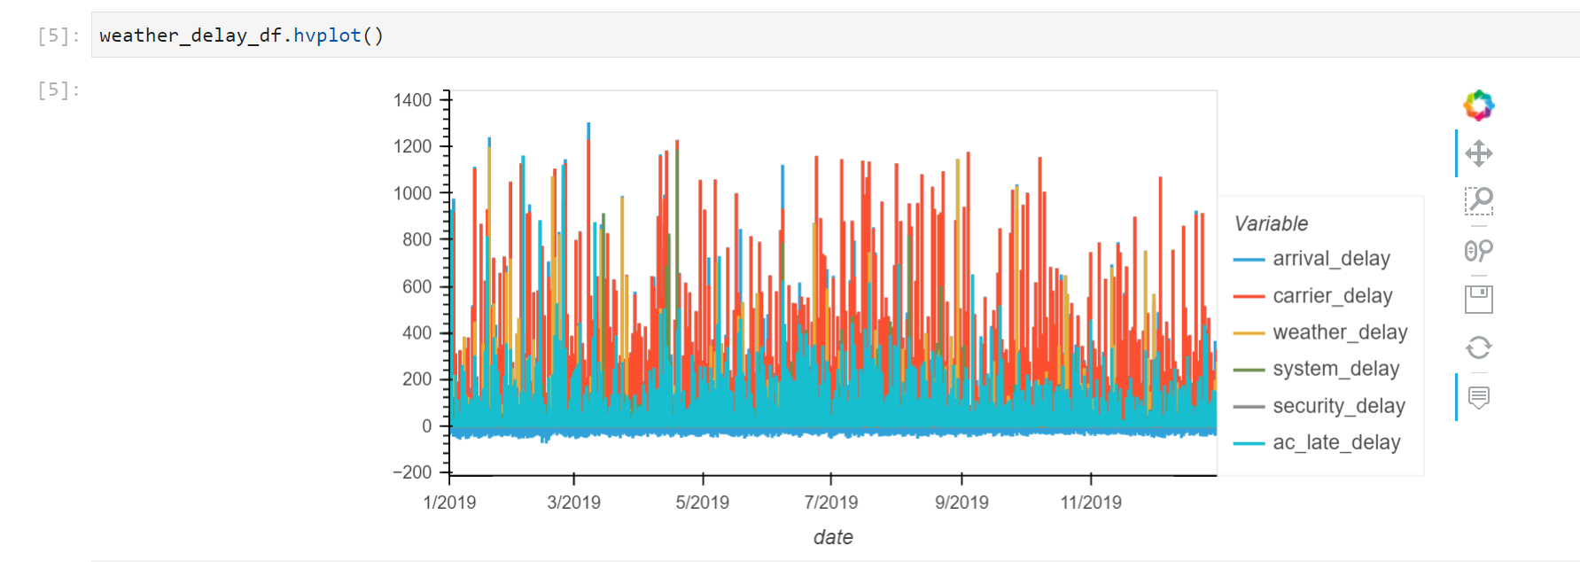
Airlines & Hubs
Focus on 4 Airlines
Delta Airlines (DAL) & Atlanta (ATL) hub
United Airlines (UAL) & Chicago (ORD) hub
American Airlines (AAL) & Dallas (DFW) hub
Alaska Airlines (ALK) & Seattle (SEA) hub

Slide 4
Metrics, Sources & Assumptions
Weather Data
Source: ()
Metrics Used: Daily precipitation, Windspeed & Visibility
Airline Performance Data
Source: (Bureau of Transportation Statistics
Metrics: Total daily flights into hub, % that are late, % cancelled
Stock Performance
Airline closing stock prices and daily percentage change
Timeframe
January 1, 2015 – December 31, 2019
5 Years of data provides 1,825 data points for airline performance
Excluded 2020 to present due to COVID and the impact on the industry

Slide 5
Baseline Stock Performance
5 Year Annual Rate of Return Holding Stock
DAL – 5.6%
AAL - (-11.2%)
UAL – 5.8%
ALK – 4.1%
Total Portfolio – 2.2%

Slide 6
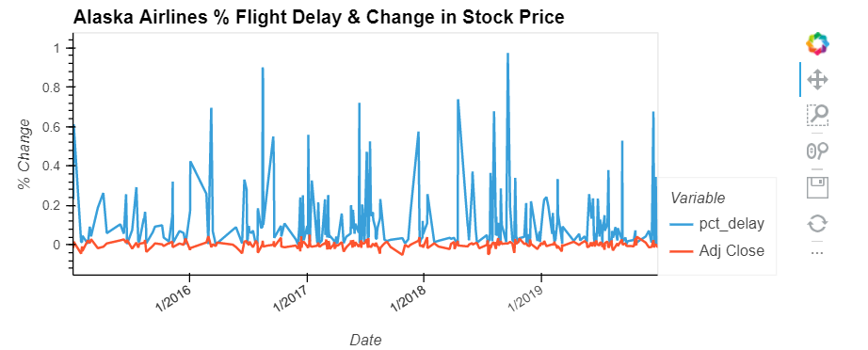
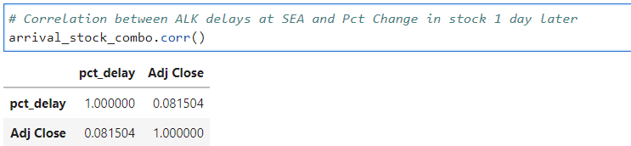
Correlation Between Stock & Flight Cancellations
Alaska Chart
Alaska Correlation

Slide 7
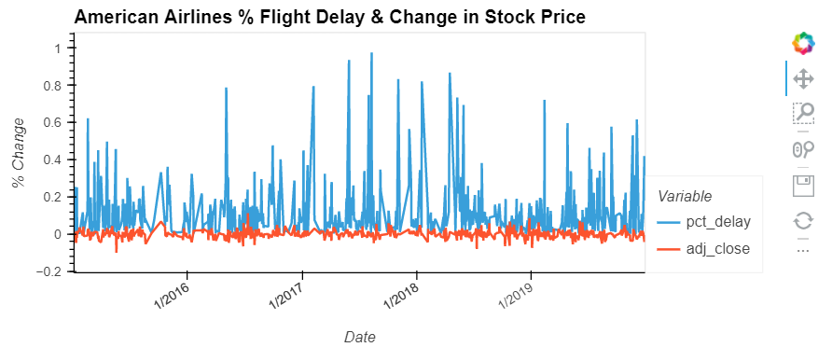
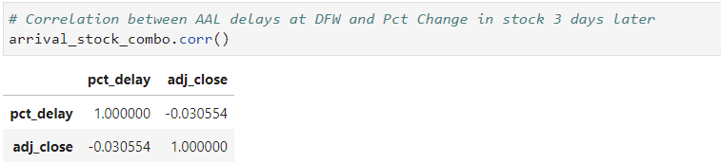
Correlation Between Stock & Flight Cancellations
American Chart
American Correlation

Slide 8
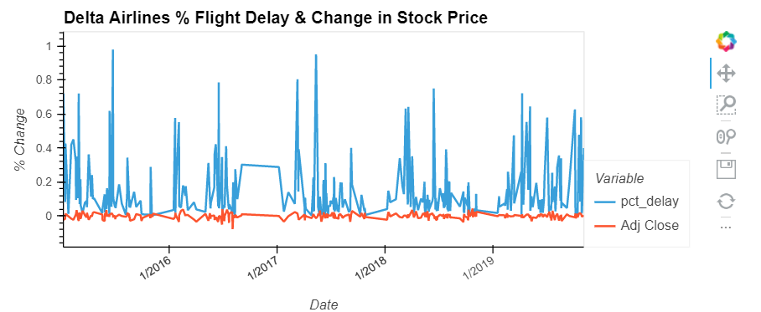
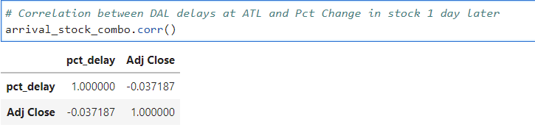
Correlation Between Stock & Flight Cancellations
Delta Chart
Delta Correlation

Slide 9
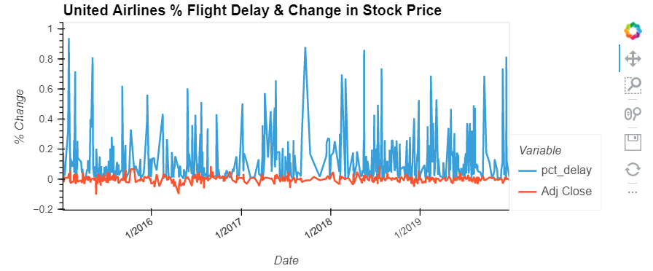
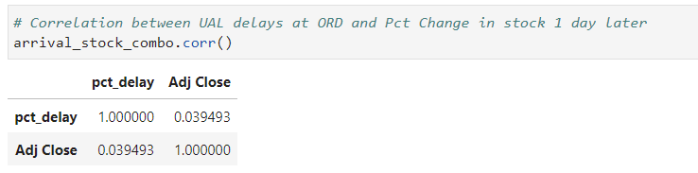
Correlation Between Stock & Flight Cancellations
United Chart
United Correlation

Slide 10
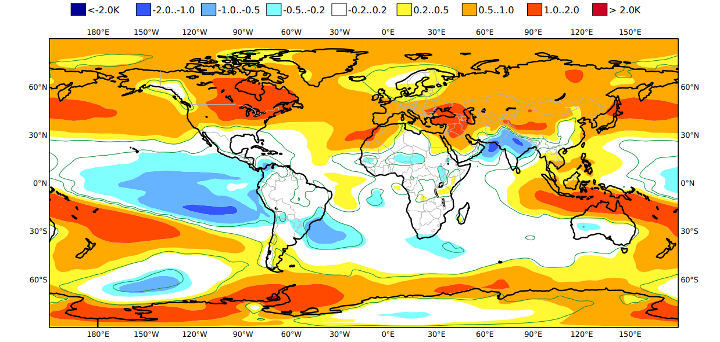

Conclusions
No correlation between weather events and stock prices identified between weather delays at hub airports and stock price changes the following day
Next steps include looking at cancellations and flights to all desitnations
Additional deep dive to build out trading platform that leverages weather forecasts and stock trades. Note: this would have required paid subscriptions from what we could find

